Slide 1
3d-Printed Granular Jamming Hand
Melissa Indoe
Chris Kang
Sean Phelan
Maggie Serra
Chris Wallace

Slide 2
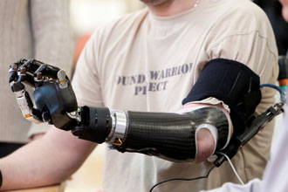
Problem Statement
There are around 12,500 arm amputations each year with 44% occurring below the elbow
Loss of an arm can severely limit the independence of a patient
Current prosthetics restore functionality but are not widely available or cost efficient
Only about half of arm amputees even get access to prosthetics
There is a global need to create an inexpensive and easily accessible prosthetic for patients

Slide 3
Project Objective
Create an open-source, high functioning, affordable, 3-D printed prosthetic hand
Costs less than $500
Able to perform a number of low-strength, high dexterity tasks
Designed for manufacture on a consumer-level 3-D printer
The prosthetic will be created using the open source design program OpenSCAD
Anyone can pull the design from the internet and make their own hand
Anyone can modify the hand to suit their own needs
Code will be well-commented for these users

Slide 4
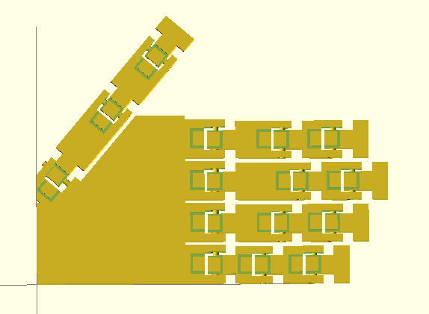
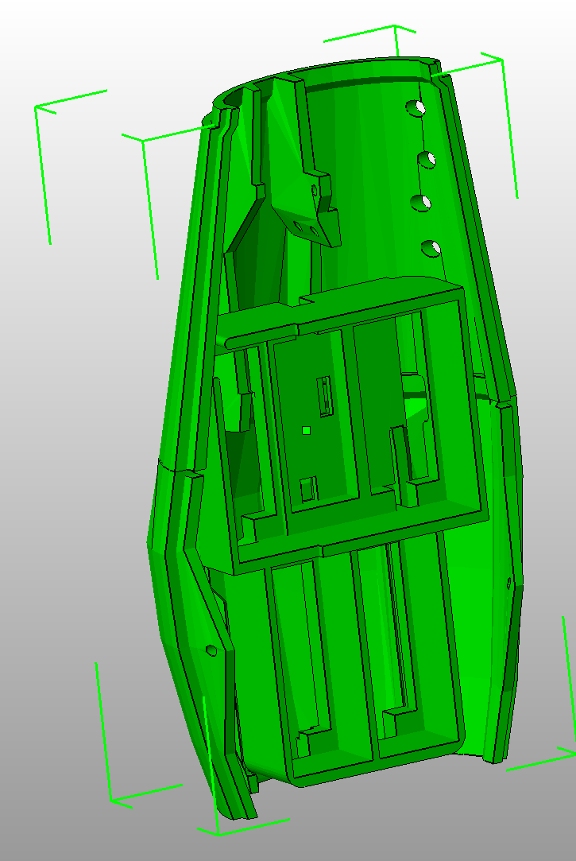
Functional Requirements
Task oriented and able to perform simple activities requiring low strength and high dexterity
Examples:
Opening doors
Picking up small to medium sized objects
Using occupational therapy tools (forks, pens, etc)
Designed for a patient who has lost an arm below the elbow
Palm and fingers will be printed in one piece
Forearm housing will be assembled

Slide 5
Project Impact
The prosthetic could have a huge impact on people who cannot access standard medical care
Humanitarian aid groups could produce the prosthetic on a case-by-case basis
With the project being open source they could easily customize depending on the case or patient
The project is also very environmentally “green”
Designed to be produced in either ABS or PLA plastics
ABS is completely recyclable and PLA is made from corn
Printing at the source of the need means that there are no industrial processes or shipping

Slide 6
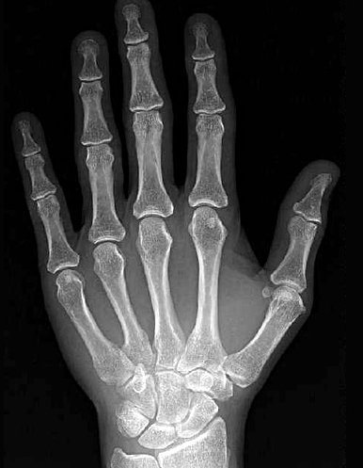
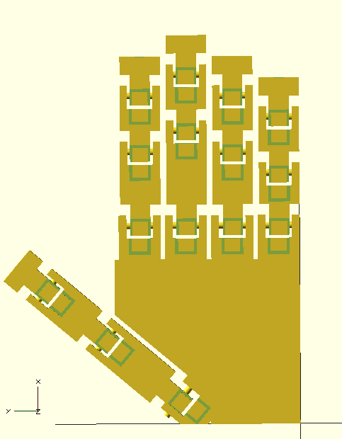
Project Review
In order for the project to meet all of the objectives stated, the team needed to design a prosthetic that mimicked a human hand in appearance, size, weight, and function
These criteria can be broken down into two main subsystems:
3D printed fingers/palm/forearm
granular jamming pad

Slide 7
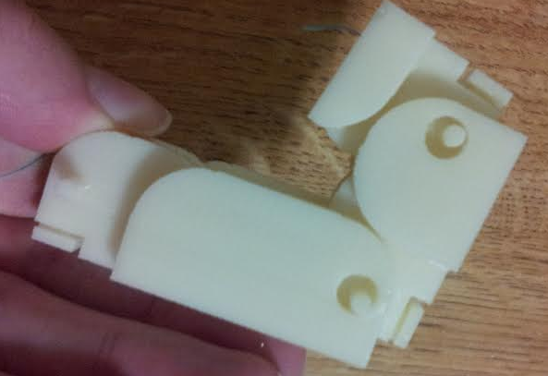
Project Review: 3D Printed Segments
Fully functional fingers have already been designed, modeled, and manufactured
These fingers are printed as a non-assembly model
The palm has been modeled and is ready for manufacture
The team has decided to modify an existing open-source forearm housing
This is because modeling curves in OpenSCAD can be complex
Additionally, the forearm is not the focus of the project
Finger prototype demonstrating full range of motion.

Slide 8
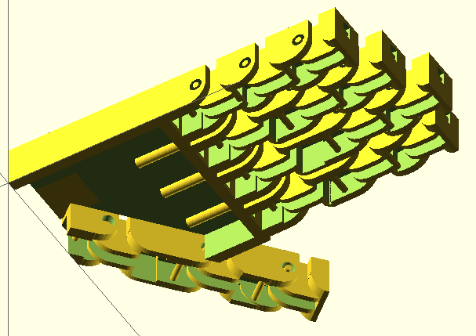
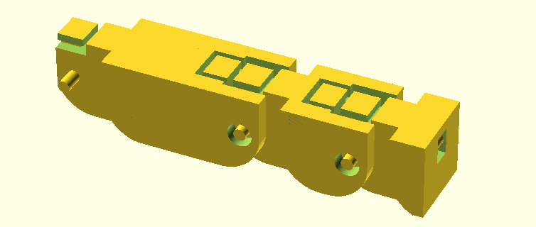
Project Review: Finger and Palm
Iterative Design—The team has already developed a fully functional finger
This finger will be run via fishing line routed up to motors in the forearm
Other parts of the design (mainly the palm), may require further iterations to come to a fully functional system

Slide 9
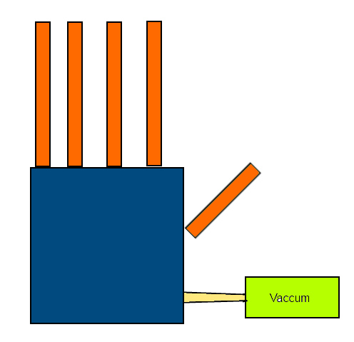
Project Review: Granular Jamming Pad
Grasps small or irregularly shaped objects
Will consist of one pad on the palm of the hand
Testing shows that this is the most simple and effective layout
Pad will be made with silicon and filled with coffee grounds
Silicon can be slip-cast to create irregular shapes
Coffee grounds are cheap, readily available, and universally recognized as the most effective granular jamming material
This pad allows the hand to pick up objects that the fingers may not be able to manipulate

Slide 10
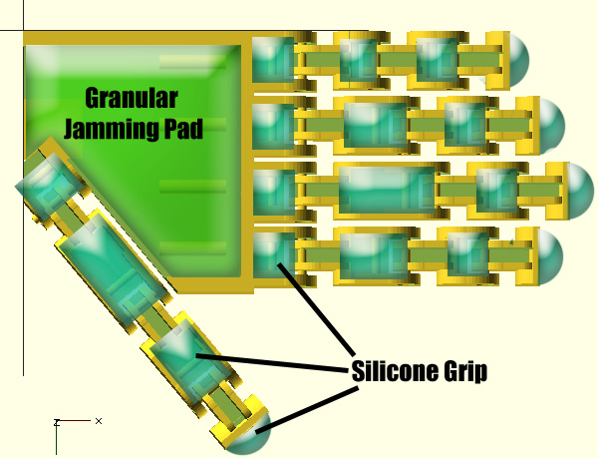
Project Review: Location/Attachment of Pad
Granular jamming pad will be glued into the palm housing
Wire guides prevent the wire from snagging under the pad
Silicone grips will be glued to the flat surfaces of the fingers

Slide 11
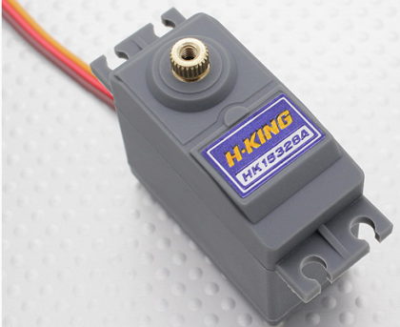
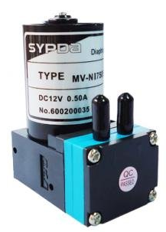
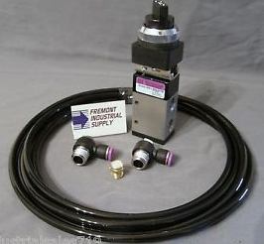
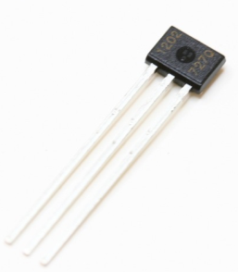
Electrical Considerations
The design requires:
Four servo motors
Four Hall Effect sensors
One pump
One motor controlled valve
Pump and servo motors require different source voltages
Battery supplies 12 volts
Pump and Solenoid use 12V
Servos require 6V
Result: We need some form of regulation to account for this change in voltage
Left to Right: Sourced motor, pump, valve, and Hall Effect sensor.

Slide 12
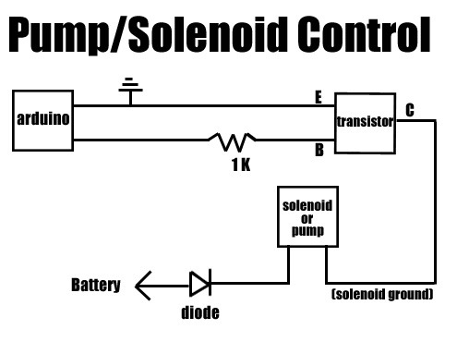
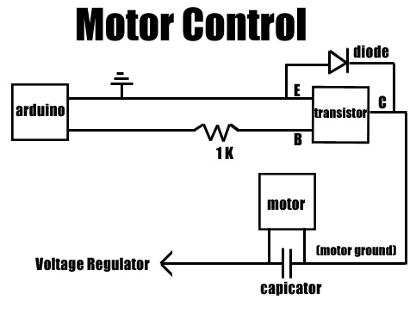
Electrical Solutions: Review
Phase 3 report includes circuit designs
These circuits would allow the Arduino to be used for control while components are powered directly from the battery
However, actually building these circuits adds a huge amount of assembly and potential sources of error
After additional consultation, the team has instead decided to employ a motor shield and two relays (one each for the valve and pump)

Slide 13
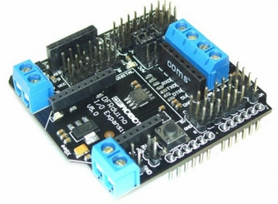
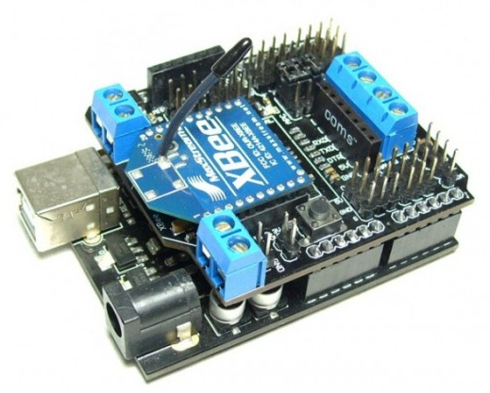

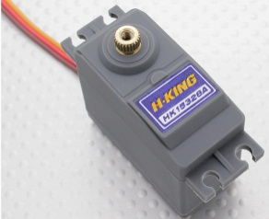
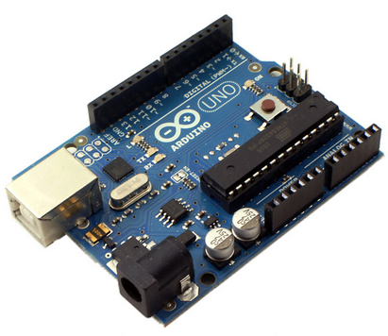
Electrical Solutions: Arduino Modules
I/O shield for servos
The 12V power supply can be plugged directly into the Arduino
The I/O shield will module this input voltage to 6V
The shield sits directly on top of the Arduino
The motors then plug directly into the shield
The Arduino can then directly control and power the motors
+
=
→

Slide 14
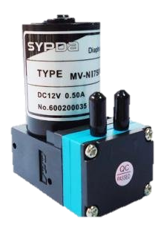
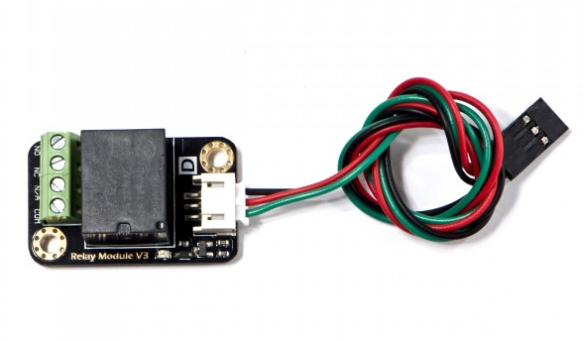
Electrical Solutions: Arduino Modules
Relay module for valve/pump
This module plugs into the shield and into the power supply
The cable end is plugged into the pins of the shield
Wires from the power supply (battery) are screwed into the green connector
It allows the motor and pump to draw the level of current that they require
This current is too high to route through the Arduino itself
This allows the Arduino to control, but not power, the pump and valve
+
x2
→

Slide 15
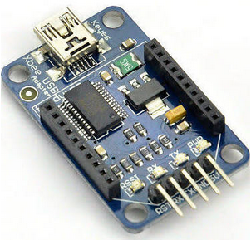
Control Consideration
All aspects of the hand will be controlled by the Arduino
The Arduino will include a Bluetooth dongle so that it can receive user commands
Developing these commands is beyond the scope of the project
However, this will allow others to build on the basic arm-level control interfaces that the team does develop
Major aspects of control:
Finger movement
Initiated by user, stopped by Hall Effect sensors
Granular jamming activation
Initiated by user or Arduino, stopped by user
This Bluetooth dongle plugs directly into the Arduino and allows it to receive commands from any Bluetooth device

Slide 16
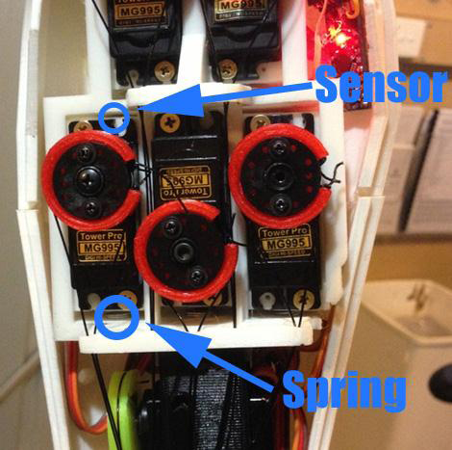
Control Consideration—Pressure Sensing
Finger pressure will be controlled using using Hall Effect sensors
Sensor setup:
Motors are contained in slides allowing them to move forward and backward
Springs push the motors to the back of the housing
A magnet is attached to the back of the motor
A hall effect sensor is attached to the back of the housing

Slide 17
Control Consideration—Pressure Sensing
As the finger contacts an object, the wire will create tension and pull the motor down the forearm, toward the hand
The harder the contact, the farther forward the motor will slide
The Hall Effect sensor senses motor displacement
This is because as the magnet, attached to the motor, moves farther away from the sensor, the Hall Effect as experienced by the sensor decreases
Once the exact relationship between finger force and displacement is found, this can be used to accurately measure finger force
This entire slide apparatus will be 3-D printed

Slide 18
Control Consideration—Pressure Sensing
This system of Hall Effect sensors in the forearm will be used because they are more robust and comprehensive than sensors in the finger
With sensors in the finger, space becomes a real issue
This way there are no wires to crimp in moving joints
This system can sense pressures anywhere in the finger
Most other systems would only be able to sense pressures at specific points
The system is also water resistant
All electronics are housed in the forearm, meaning that there is no chance of sensors getting wet when the hand gets wet
This is useful for a number of day-to-day tasks that may involve hand-washing, walking in rain, etc
Housing all electronics in the forearm also makes the sensor systems easily accessible for replacement

Slide 19
Control Consideration—Granular Jamming
1st method: Automatically activate granular jamming pad when enough fingers are in contact with an object
This is a way for the granular jamming pad to help improve grip by the hand
When enough Hall Effect sensors register a significant force at the fingers, the granular jamming pad will automatically turn on
Computation for this will be done onboard the Arduino
2nd method: Activate manually
This will be done either via Bluetooth control or with a button
This will allow users to activate the pad without use of the fingers
Useful for picking up small objects that the fingers cannot manipulate
Also useful for situations where not enough fingers register pressure

Slide 20
Safety Considerations
Nothing in the design is considered to be particularly dangerous
If a large amount of water got into the forearm it would damage the electronics
The Arduino and wires should be shrink wrapped
This will provide protection against some water
It will not protect against submersion
One consideration:
Addition of a “kill-switch”
if the hand encounters a problem where it won’t release grip or the pump will not stop running, this would shut off all electronics
The force exerted by the motors is not nearly enough to injure someone
No real considerations have to be made for motor force
While the battery does represent a minor fire hazard, it is has its own built-in safety features to prevent injury

Slide 21
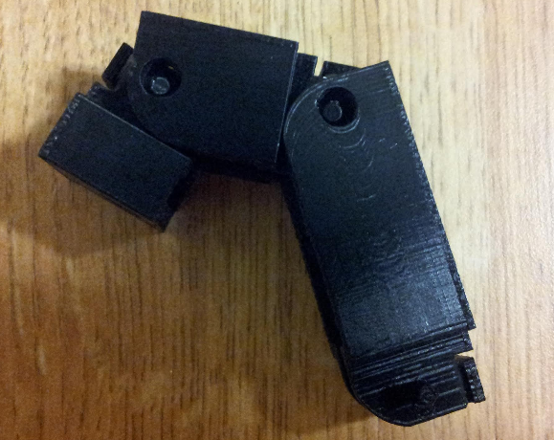
Mechanical Design
Design iterations have continued since phase two
Most notably, the finger is now fully functional
In phase two a manufacturability analysis was performed determining if the finger could be printed as a non-assembly model
The resulting finger could bend freely but had some interference at the joint interfaces preventing full range of motion
Additionally the joint guides were non-functional
This finger served as an excellent proof-of-concept, but was not yet complete
Previous finger iteration at maximum bent position

Slide 22
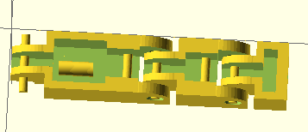
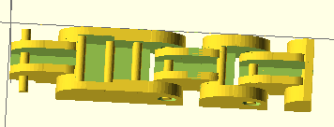
Mechanical Design—Solution
The new design features wider spaced joints with additional rounded edges
These rounded edges both prevent joint interference and improve the aesthetics of the finger
Fully redesigned wire guides
The wire guides have been completely reworked and are now totally functional
Previous finger iteration (left) and new design (right)

Slide 23
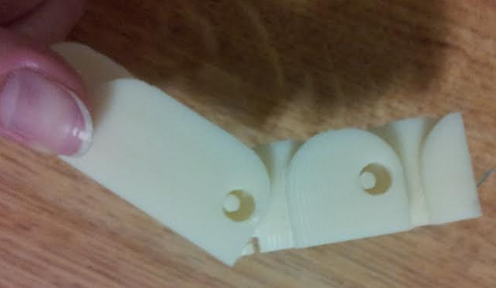
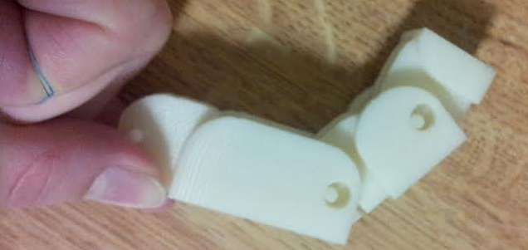
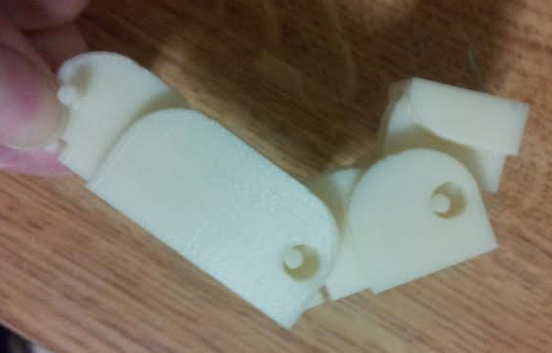
Mechanical Design—Solution
With these changes, the finger is fully functional and ready to manufacture
Range of motion is extremely realistic
Bends first at middle joint, then at fingertip, just like a real finger
Now focus can be shifted to manufacturing the fingers in conjunction with the palm
Ultimately the entire hand will be printed as one piece
Motion Progression when string is pulled.

Slide 24
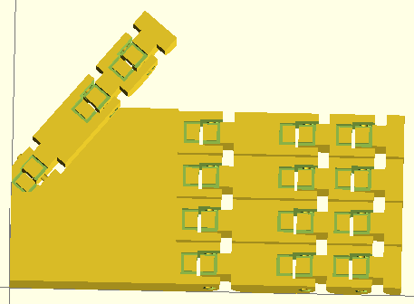
Professional Drawings/Assembly Models
Since the final report, a few updates have also been made to the hand model
Most notably it has been modified so that the fingers are similar in proportion to a human hand
This is mostly a cosmetic change, however it does make the prosthetic much less blocky and more relatable
Before modifications (left) and after (right).

Slide 25
Professional Drawings/Assembly Models
The forearm housing will be pulled from the InMoov
The InMoov is an existing open-source humanoid robot project
This forearm will be used because it is already designed around 3D printability, and because it offers a very realistic forearm shape
Motor mounts on the InMoov are currently being redesigned for the Hall Effect sensor setup
InMoov forearm housing with motor mounts.

Slide 26
Next Semester Deliverables
A final design has been completed, by next semester parts will be ordered and a prototype will be built, tested, and improved on
The group will work to develop the best possible prosthesis via continued iterative design
The design will continue to be modified as prototypes are developed
A website for the project will be completed during phase four
By the end of next semester, the group will complete a fully functional prosthetic hand

Slide 27
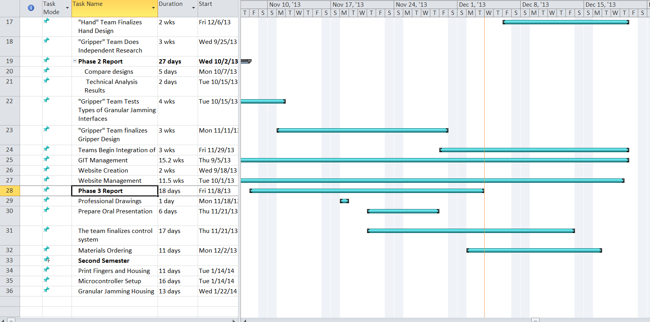
Gantt Chart

Slide 28
Bill of Materials

